Slide 1

introduction and safe practices
MercedEnergy.com
11-22-2018
Soldering Group

Slide 2
What is soldering?
Pronunciation : “Soul-de-ring” ,“sah-der-ing”.
From the latin word “solidare”, meaning “to make solid”
The solder melts easily, generally the “solder” is a metal alloy.
Soft Soldering refers to lower temperatures such as below 450 degrees Celsius
Electronics are very sensitive, therefore Soft Soldering is the only way.
Hard Soldering refers to high temperatures, that is above 450 degrees Celsius

Slide 3
Electrical soldering
Not to be confused with “Electrical Discharge Soldering”
- A pulse of electricity that heats up the tip.
Soldering Irons powered by electricity tend to be safer.
Make sure the Soldering Iron is UL certified.
“These requirements are often based on UL's published and nationally recognized Standards for Safety.”
Some Soldering Irons use gas or butane, and should be used properly, or not at all.
Difficult to regulate temperature.
To be used only when there is no electricity around. Like the woods, or in a remote area.

Slide 4
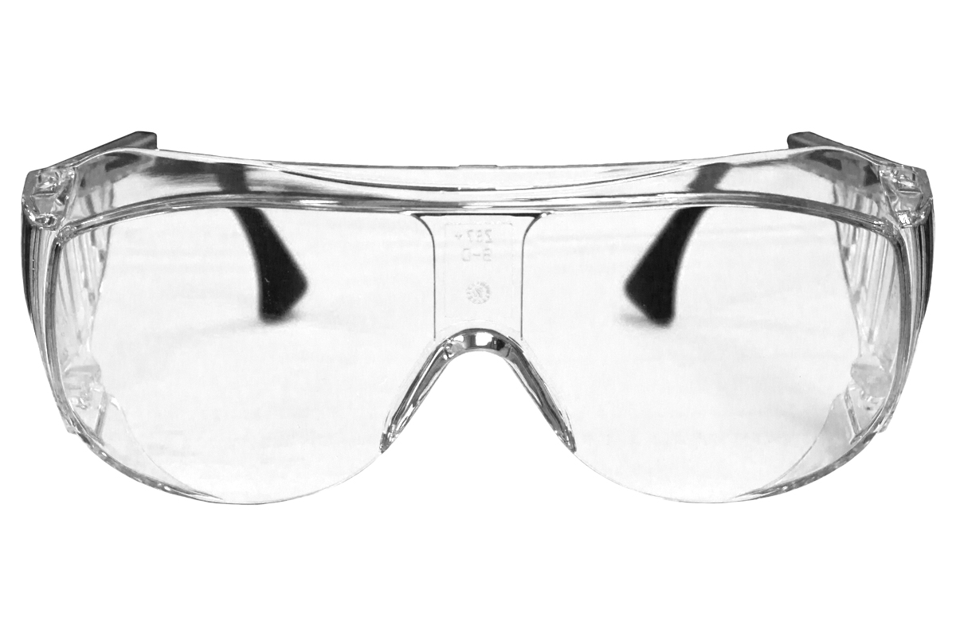
Safety!!
Make sure to protect your eyes.
Wear safety goggles/glasses
If you damage your eyes, you will live that way for the rest of your life!
Use a timer, such as your phone, Remind you to turn of soldering iron.
A soldering iron that turns of on it’s on can save lives.

Slide 5
FUMES
Make sure to work in a place that is well ventilated.
Fumes are very dangerous.
Consider a Fume Extractor.
Do not work in small rooms, or closed windows.

Slide 6
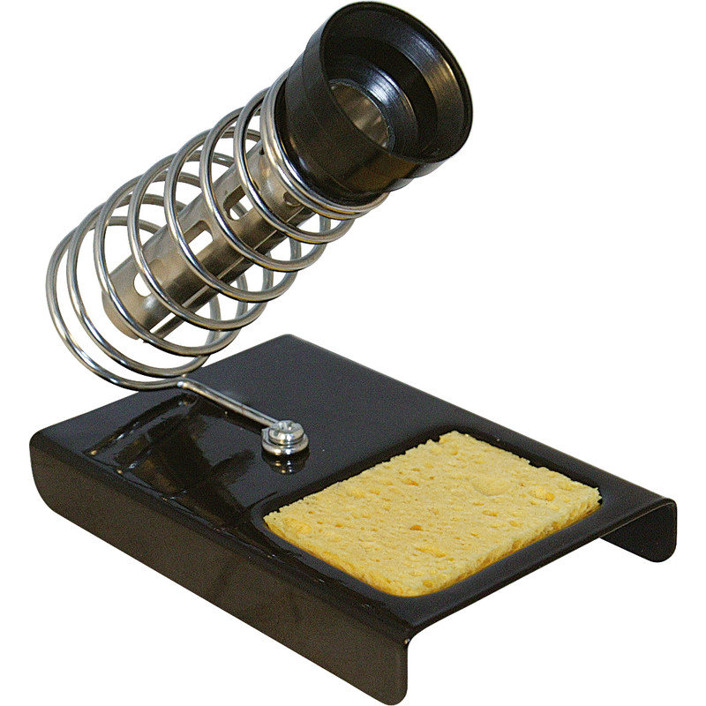
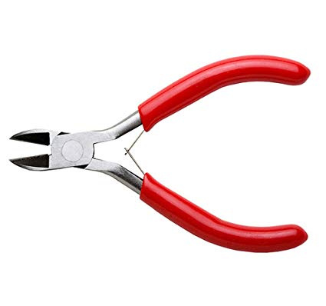
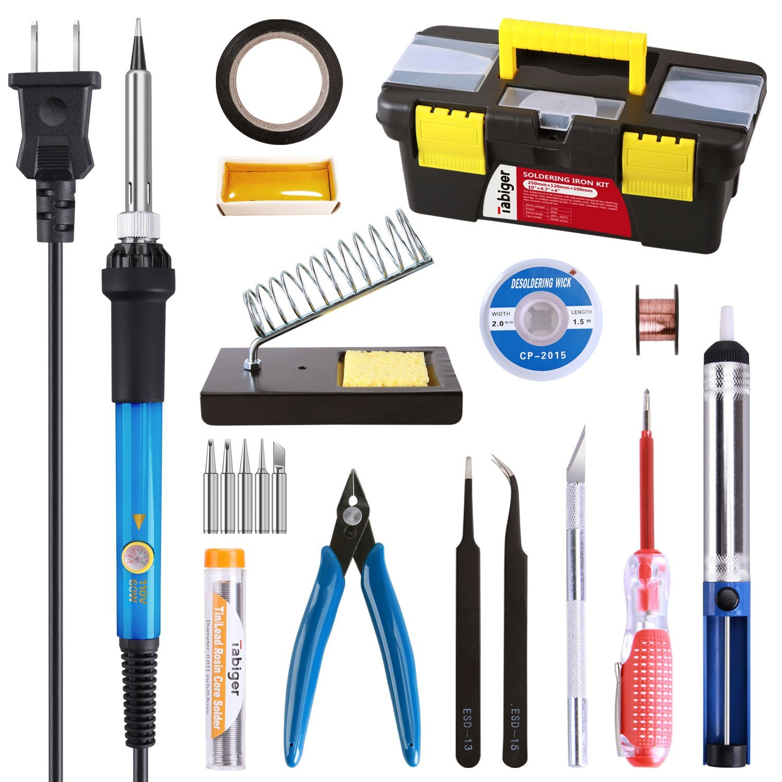
Tools
Safety!!!!!!!!
Safety Glasses, Gloves
Soldering Iron & Stand
Stand: Wound up springs.
Wire Cutters
Damp Sponge
Solder
* Buy A Soldering Kit *
Wire Cutters
Stand & Sponge
Soldering Kit

Slide 7
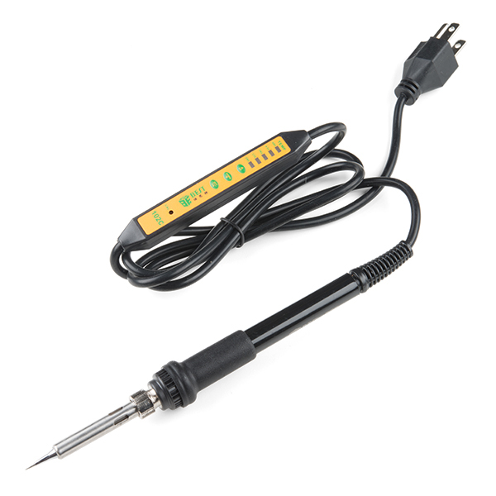
Soldering iron
Electrical Soldering Iron. (There are other types of soldering)
Used to generate heat, to heat up the solder.
Will only melt the solder, not the other components.
An adjustable soldering iron is recommended.
Low Wattage = Longer to warm up
High Wattage = Faster warm up
https://www.sparkfun.com/products/14456

Slide 8
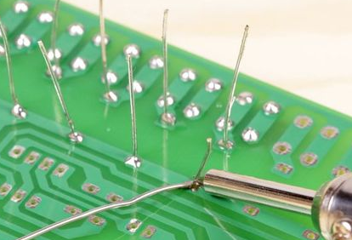
Trimming Leads
Use a wire cutter to clip the leads.
Hold the lead when clipping.
Leads may become projectiles, this can be dangerous.
Or place your hand over it.
Handle the leads properly.
Use a magnet to collect them.
Wire leads are dangerous and may short batteries or the project.

Slide 9
Welding
In soldering only the soldering melts.
All materials to be joined are melted.
Use of flame, or electrical arc.
Plastic welding is also positive.
There are man ways to weld.

Slide 10
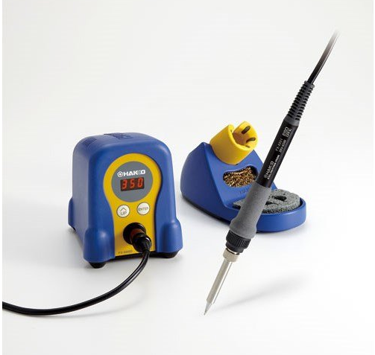
Soldering station
Can last a long time.
Are very safe.
More reliable than cheap soldering kits.
Fast heat up times.
---- Hakko Digital Soldering Station

Slide 11
Using a sponge
Make sure the tip of the soldering iron is clean.
Using a wet sponge may cool down the soldering iron tip.
Do not use a sponge from your kitchen. Use sponge specifically made for soldering, regular sponges are not able to handle high temperatures.
Using a brass sponge is recommended.

Slide 12
Diagonal cutting pliers
Useful when soldering electronics.
Can trim leads better. Closer to the board.
Used to strip wire.
The other type of plier is called “linemen’s pliers”.

Slide 13
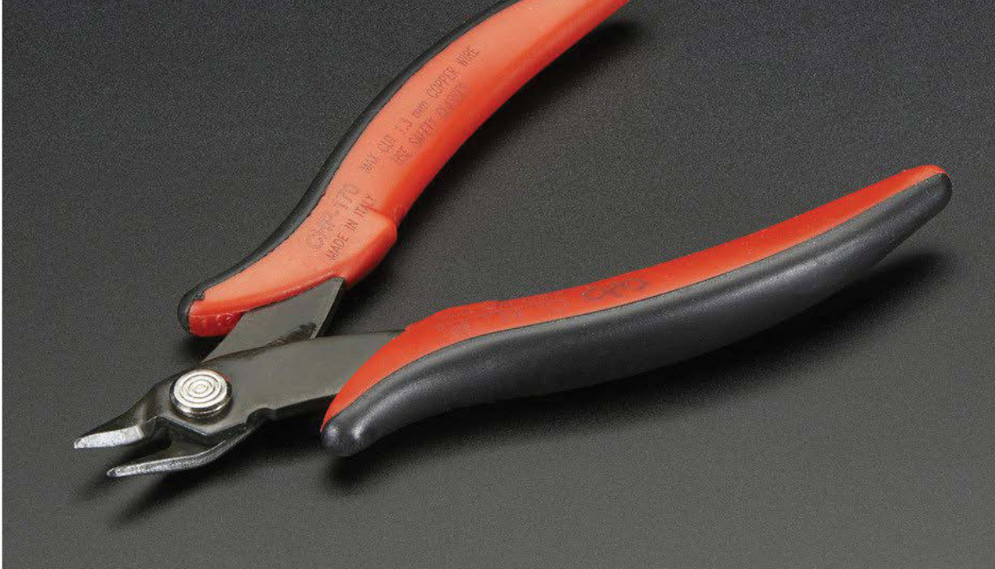
Diagonal flush cutting pliers
Recommended for trimming leads.
Very good for projects dealing with electronics.

Slide 14
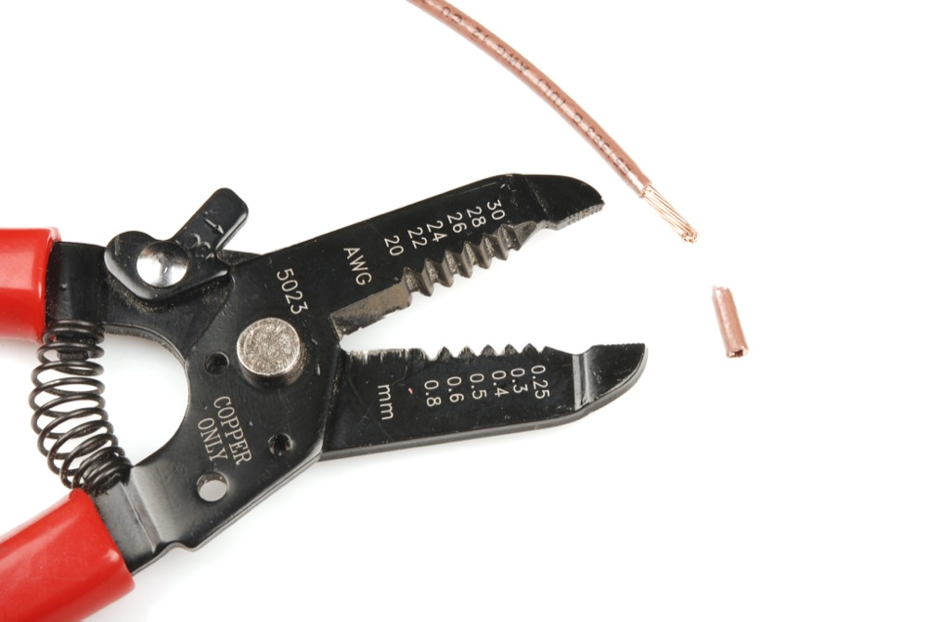
Wire strippers
There are different types of wire strippers.
The type you use depends on the wires.
Used for stranded wires.
Generally you may use Diagonal Flush Cutting Pliers for wire stripping solid core wire.
Do Not Use Your Teeth To Strip End Of Wires!
Solder may contain lead! Which may contaminate it’s surroundings.

Slide 15
Thank You!
Ramiro Gonzalez
www.ramirogonzalez.org
209-962-2524
ramirogonzalez@mercedenergy.com
https://github.com/mercedcyber/
https://github.com/mercedenergy

